Slide 1


S. K.
3 August 2024
Space Y Corporation

Slide 2

Outline
Executive Summary
Introduction
Methodology
Results
Conclusion
Appendix

Slide 3
Executive Summary
Methodologies: Data analysis including… 1. data collection 2. data wrangling 3. exploratory data analysis (EDA) 4. visual analysis 5. predictive analysis
Results:
Space X saves costs if it can reuse the first stage
Possible in 66% of the cases (especially Orbit Type, Flight Number, Payload Mass and Launch Site affect the success)
Prediction possible with Decision Tree Classifier

Slide 4
Introduction
Space X launches cost less than competitors
Why? They reuse the first stage of a rocket launch if successfully recovered
To be competitive the following question need to be answered:
What is the price of a given launch from Space X?
Underlying question: Will Space X reuse the first stage for a given launch?

Slide 5

Section 1

Slide 6
Methodology
Executive Summary
Data collection methodology: Via Space X API and Wiki pages
Perform data wrangling: Replace missing values, Extract labels for columns of type object if required for analysis
Perform exploratory data analysis (EDA) using visualization and SQL
Perform interactive visual analytics using Folium and Plotly Dash
Perform predictive analysis using classification models using sklearn

Slide 7
Data Collection
Source: Space X API, Wiki pages Python libraries: requests, pandas, beautifulsoup4
The collection process for each:
Space X API has required data
Wiki page with HTML table with required data
Get data
Get and convert table into BeautifulSoup object
Convert to DataFrame
Extract data from table
Clean DataFrame *
Convert to DataFrame
* Clean = if required: remove not required cells; ensure one value per cell; restrict time interval

Slide 8
Data Collection – SpaceX API
GET https://api.spacexdata.com/v4/launches/past
https://github.com/Sophia-attempto/coursera_ibm_data_science_capstone/blob/main/spacex_assignment/0_1_spacex_data-collection-api.ipynb
ID given in data?
GET https://api.spacexdata.com/v4/rockets/<rocket ID>
GET https://api.spacexdata.com/v4/launchpads/<launchpad ID>
GET https://api.spacexdata.com/v4/payloads/<payload ID>
GET https://api.spacexdata.com/v4/cores/<core ID>

Slide 9
Data Collection - Scraping
GET https://en.wikipedia.org/w/index.php?title=List_of_Falcon_9_and_Falcon_Heavy_launches&oldid=1027686922
https://github.com/Sophia-attempto/coursera_ibm_data_science_capstone/blob/main/spacex_assignment/0_2_spacex_data-collection-webscraping.ipynb
Create BeautifulSoup object from response.content
Extract tables and find target table
Extract values from th elements for column names into dictionary
Extract values from td in tr elements for column values into dictionary
Convert dictionary into DataFrame

Slide 10
Data Wrangling
First insight: the success rate of Space X past recoveries of the first stage is round about 66%
https://github.com/Sophia-attempto/coursera_ibm_data_science_capstone/blob/main/spacex_assignment/1_spacex_data-wrangling.ipynb
Replace missing values
Identify missing information
Add column with classification variables determined from landing outcome

Slide 11
Exploratory Data Analysis (EDA) with Data Visualization
EDA Goal: identify features in the data which have an affect on the Landing Outcome success rate
Plotted charts:
Five scatter point charts: how do features relate?
Bar chart: how do features relate?
Line chart: how is the yearly trend of Landing Outcome success?
https://github.com/Sophia-attempto/coursera_ibm_data_science_capstone/blob/main/spacex_assignment/2_spacex_eda-data-visualization.ipynb

Slide 12
EDA with SQL – Part 1
https://github.com/Sophia-attempto/coursera_ibm_data_science_capstone/blob/main/spacex_assignment/3_spacex_eda-sqllite.ipynb
Select unique launch site names for an overview
Select launch sites starting with CCA for an overview
Select total payload mass of rockets launched by NASA (CRS)
Select average payload mass of rockets with booster version F9 v1.1
Select date when first Landing Outcome success was achieved
Select booster names with Landing Outcome success on drone ship and Payload Mass greater than 4000 but less than 6000

Slide 13
EDA with SQL – Part 2
Select total number of Mission Outcomes success and failure
Select Booster Versions which have carried the max. Payload Mass
Select Landing Outcome failure on drone ship in year 2015
Select count of Landing Outcomes between 2010-06-04 and 2017-03-20

Slide 14
Build an Interactive Map with Folium
Goal: Identify factors for an optimal launch site location
Added map objects:
Circles for space X launch site locations: to get an overview
Red and green markers for Launch Outcomes: to see the success rate per launch site
Lines: to analyze distances to proximities (railway, highway, city, equator line...)
https://github.com/Sophia-attempto/coursera_ibm_data_science_capstone/blob/main/spacex_assignment/4_spacex_folium_launch_site_location.ipynb

Slide 15
Build a Dashboard with Plotly Dash
Added dashboard elements:
Dropdown: to select all or a specific Launch Site
Pie chart:
For all: to show the total successful launches count for all sites
For specific: to show the Success vs. Failed counts for the site
Slider: to select Payload Mass range for the scatter chart
Scatter chart: to show the correlation between Payload Mass and Launch success
https://github.com/Sophia-attempto/coursera_ibm_data_science_capstone/blob/main/spacex_assignment/5_spacex_dash_app.py

Slide 16
Predictive Analysis (Classification)
Preprocess the data
Goal: find best performing classification model
https://github.com/Sophia-attempto/coursera_ibm_data_science_capstone/blob/main/spacex_assignment/6_spacex_ML_prediction.ipynb
Split data into training and test data
Find best hyperparamters via GridSearch for SVM, Classification Trees, K nearest neighbors and Logistic Regression
Compare accuracy on the test data and select the best performing model

Slide 17
Results
Exploratory data analysis results
Interactive analytics demo in screenshots
Predictive analysis results

Slide 18

Section 2

Slide 19
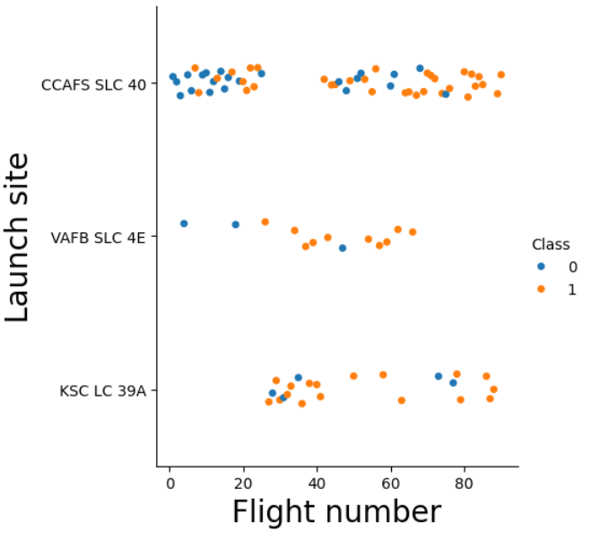
Flight Number vs. Launch Site
Insights:
the higher the Flight Number the more likely is a successful recovery
CCAFS SLC 40 and KSC LC 39A both have higher flight numbers than VAFB SLC 4E

Slide 20
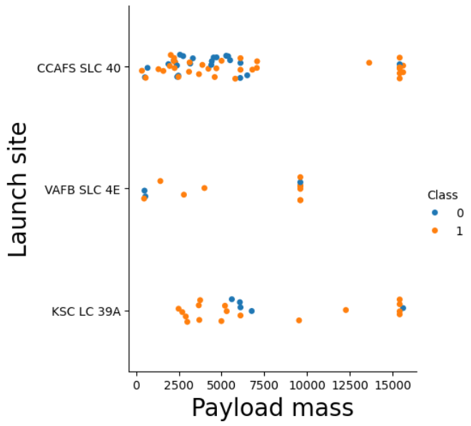
Payload vs. Launch Site
Insights:
the more massive the Payload the less likely is a successful recovery
VAFB SLC 4E has no rockets launched for heavypayload mass (greater than 10000)

Slide 21
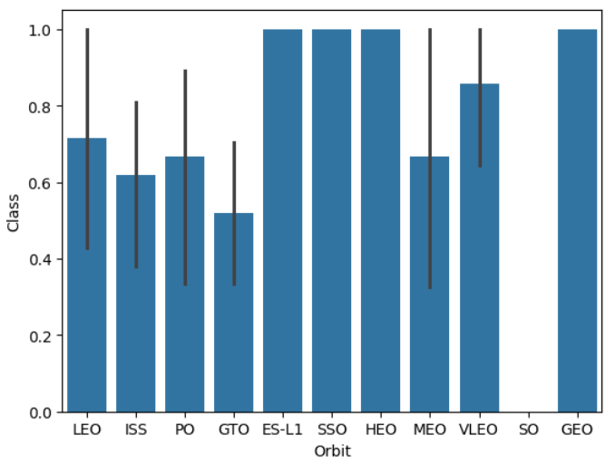
Success Rate vs. Orbit Type
Insight:
Orbit Types with high success rate: ES-L1, SSO, HEO, GEO

Slide 22
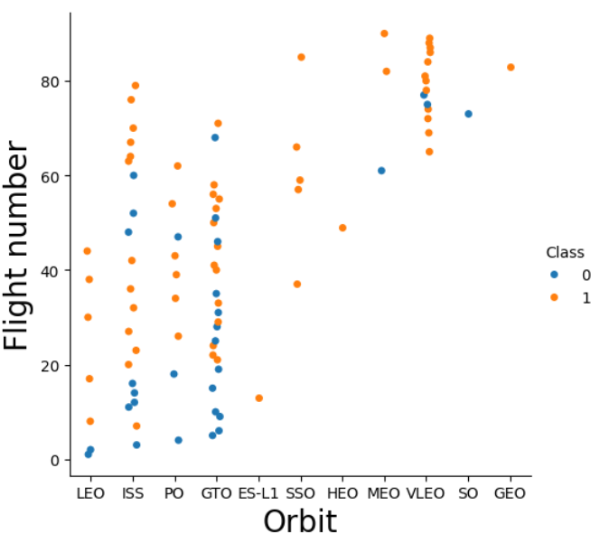
Flight Number vs. Orbit Type
Insights:
LEO: the higher the Flight Number the more likely the success
GTO: no relationship

Slide 23
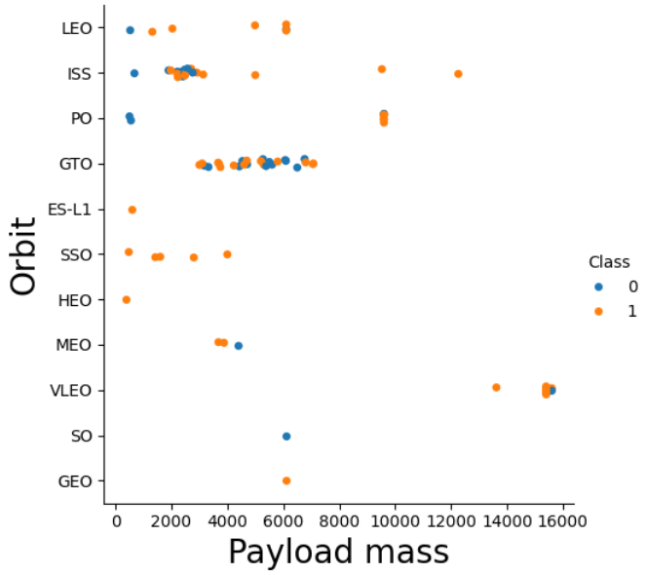
Payload vs. Orbit Type
Insights:
Polar, LEO and ISS: with heavy payloads more successes
GTO: no relationship

Slide 24
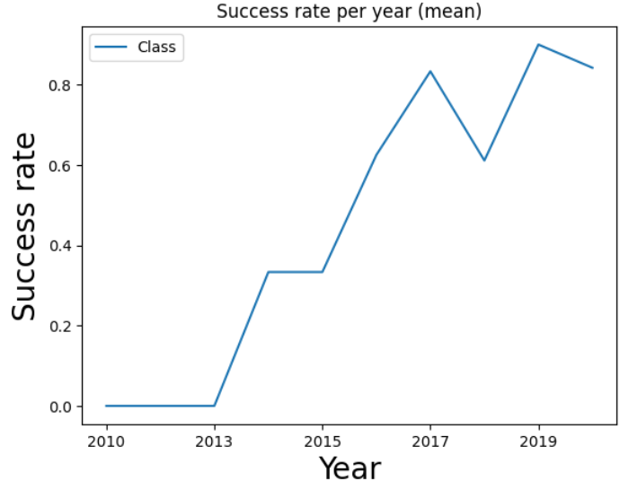
Launch Success Yearly Trend
Insights:
Since 2013 success rate kept increasing till 2017

Slide 25
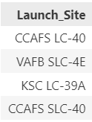
All Launch Site Names
Unique Launch Site Names:

Slide 26
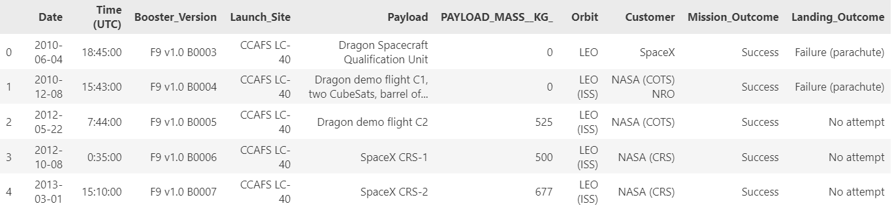
Launch Site Names Begin with 'CCA'
First 5 records where launch sites begin with `CCA`:

Slide 27
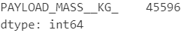
Total Payload Mass
Total payload carried by boosters launched by NASA (CRS):

Slide 28
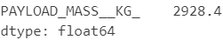
Average Payload Mass by F9 v1.1
Average payload mass carried by booster version F9 v1.1:

Slide 29
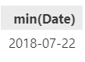
First Successful Ground Landing Date
Date of the first successful landing outcome on ground pad:

Slide 30
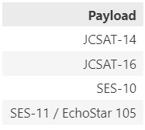
Successful Drone Ship Landing with Payload between 4000 and 6000
Names of boosters which have successfully landed on drone ship with Payload Mass greater than 4000 but less than 6000

Slide 31
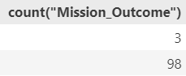
Total Number of Successful and Failure Mission Outcomes
3 failure vs. 98 successful mission outcomes:

Slide 32
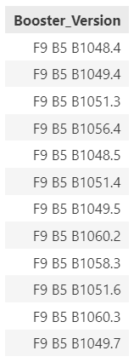
Boosters Carried Maximum Payload
Names of the booster which have carried the maximum Payload Mass:

Slide 33
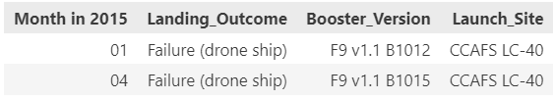
2015 Launch Records
Failed Landing Outcome in drone ship, booster versions, and launch site names per month in year 2015

Slide 34
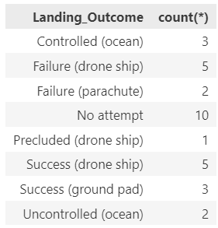
Rank Landing Outcomes Between 2010-06-04 and 2017-03-20
Count of landing outcomes (such as Failure (drone ship) or Success (ground pad)) between the date 2010-06-04 and 2017-03-20, in descending order:

Slide 35

Section 3

Slide 36
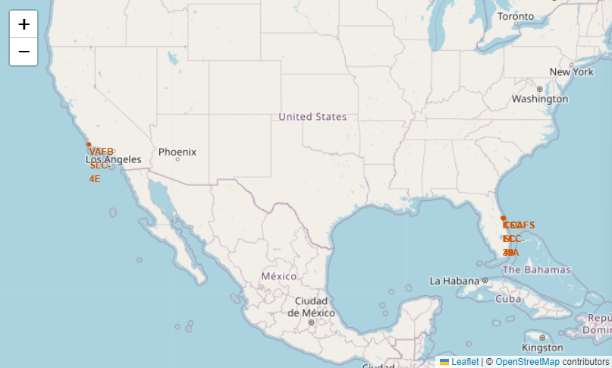
Space X Launch Site locations
Insights:
All launch sites are in proximity to the Equator line
All launch sites are in proximity to the coast

Slide 37
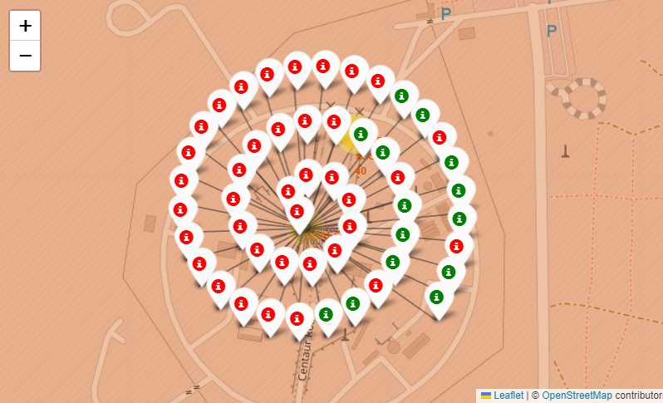
Launch Outcomes for Launch Sites
Example for Launch Site CCAFS SLC-40:
Insights:
CCAFS SLC-40 has the most launches
KSC LC-39A has the most successful launches

Slide 38
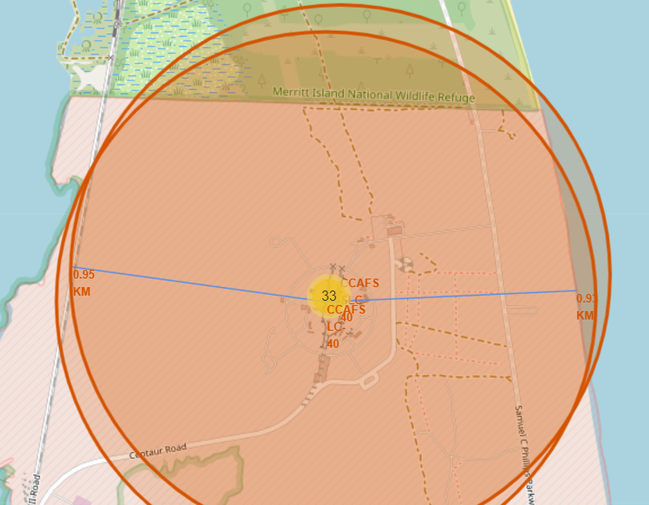
Proximities to Launch Sites
Insights:
Near the launch sites are the coast, railways and highways
Cities are not in proximity

Slide 39

Section 4

Slide 40
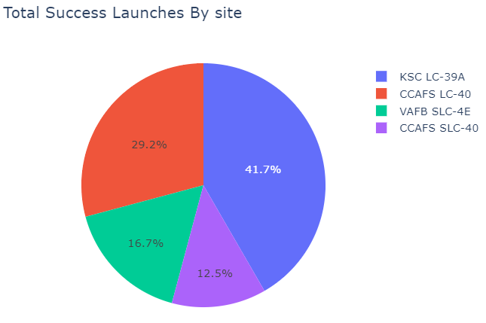
Total success launch ratio for all sites
Insights:
KSC LC-39A has the highest launch success ratio
CCAFS SLC-40 has the lowest launch success ratio

Slide 41
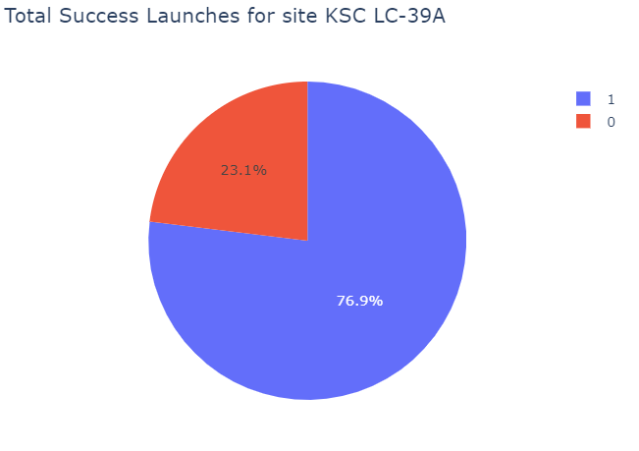
Total success launch ratio for KSC LC-39A
Insight:
76.9% successful launches

Slide 42
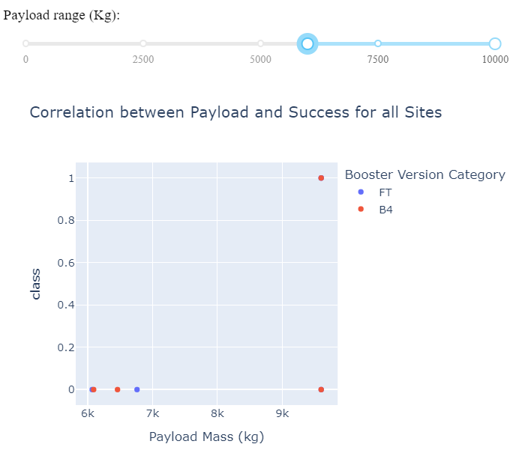
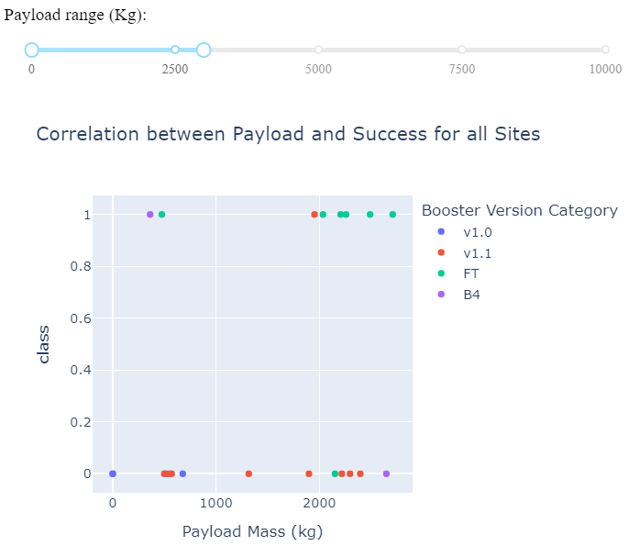
Payload vs. Launch Outcome for all Launch Sites
Insights:
Booster version F9 B4 with payload mass 9600 has the largest launch success rate
Booster version F9 B4 with payload mass 362 has the lowest launch success rate

Slide 43

Section 5

Slide 44
Classification Accuracy
The decision tree classifier model has the highest accuracy

Slide 45
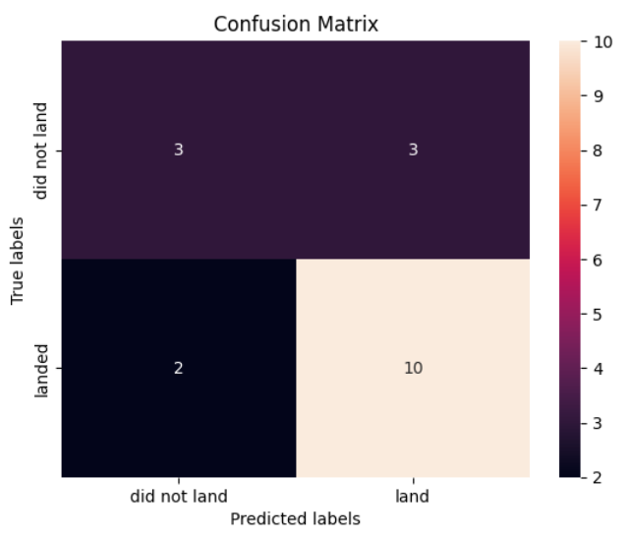
Confusion Matrix of the best performing model
The decision tree classifier performed best with an accuracy of 86%
Some false positives and false negatives are given

Slide 46
Conclusions
Will Space X reuse the first stage for a given launch?
In 66% of the cases
Factors that hint at a reuse:
Orbit Type: ES-L1, SSO, HEO, GEO
Higher Flight Number
Less massive Payload Mass
Launch Site: KSC LC-39A
Best model for prediction: Decision Tree Classifier

Slide 47
Appendix
Relevant assets are included in the GitHub repository: GitHub Repo Link
Possible follow up research can look into:
Why has the Launch Site KSC LC-39A the most successful launches?
Why does Space X have little success rate for the orbit types GTO, PO, ISS, LEO, MEO?

Slide 48


